Slide 1
Palliative care
as an integrated
medical discipline

Slide 2
Objectives:
Define palliative care;
Explain holistic principles of practice for palliative care;
Describe the impact for patients and their families of living with a life-limiting condition
Explain how palliative care fits within medical care and public health agenda;

Slide 3
What is palliative care?
What are the first 3 words
that come to your mind
when thinking of palliative care
and that should be part of
a definition of palliative care?
Exercise (10 min):
Write individually at least 3 words
Feedback (flipchart)

Slide 4
…What is palliative care?
Palliative care is an approach that improves the quality of life of patients and their families facing the problem associated with life-threatening illness, through the prevention and relief of suffering by means of early identification and impeccable assessment and treatment of pain and other physical, psycho-social and spiritual problems.
Sourca: WHO definition, https://www.who.int/cancer/palliative/definition/en/

Slide 5
https://www.youtube.com/watch?v=ttW8pxF__g4
Video (3 minutes)

Slide 6
Terminology
« Hospice » - different meanings in different countries:
  Defines:
  a concept of care,
  a building where this type of care is provided,
  the support and care provided by volunteers for patients at the end of life;
Recommended term (Romania) « palliative care »
Etymology:
  “hospes”= host
  “pallium”= cloak
  *Morris, D. (1997), Palliation: shielding the patient form the assault of symptoms

Slide 7
When is palliative care appropriate?
Initial Concept...
ACTIVE TREATMENT (”CURATIVE”) | PALLIATIVE CARE
Implications:
For the professionist– frustration, therapy failure
For the patient– feeling abandoned by the healthcare system

Slide 8
When is palliative care appropriate?
Later...
Therapies to modify the disease
Bereavement
Therapies to prevent and relieve suffering =
Palliative Care
Diagnosis
RIP
Implicațions:
For the professionists - Early intervention and support capacity from the meoment of diagnosis, adapted to the patient/family needs
For the patient – understanding of the disease and its evolution, better compliance to treatment, improved quality of life till the very end, less invasive interventions

Slide 9
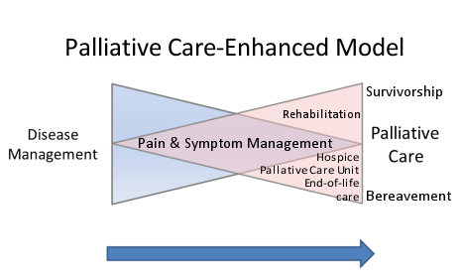
When is palliative care appropriate?
Today...
Survival
Palliative care
Bereavement
Rehabilitation
Disease management
Pain and symptoms management
End-of-life care
Sursa: http://www.virtualhospice.ca/en_US/Main+Site+Navigation/Home/For+Professionals/For+Professionals/The+Exchange/Current/The+Bow+Tie+Model+of+21st+Century+Palliative+Care.aspx. Accessed by Ariana osiu on the 13th of sept.2018

Slide 10
Principles of palliative care?
Treats the patient, not the disease;
Improves the quality of life;
Affirms life and regards dying as a normal process;
Neither hastens nor postpones death[…]
Considers the patient and the family as a unit of care;
Provides holistic care, in interdisciplinary team;
Supports the family during the patient’s illness and during the bereavement time.

Slide 11
Who needs palliative care
Patients with:
Cancer
Progressive neurological conditions
Chronic organ failure (cardiac, renale, liver)
Lung diseases in advanced stages
HIV/AIDS
Severe pediatric congenital diseases
Other life-limiting/chronic progressive conditions and rare diseases

Slide 12
Pattern of dying – changed over a century
UK, 1900
Age at death: 46
Top 3 causes of death
1. Infectious diseases
2. Accident
3. Childbirth
Disability before death
Not much
UK, 2010
Age at death: 80
Top 3 causes of death
1. Cancer
2. Organ failure
3. Frailty/Dementia
Disability before death
Long time (months to years)
Source: Murray, S. A et al. BMJ 2008;336:958-959

Slide 13
Palliative care and the disease trajectory
  Concept that helps understanding the experience and the specific needs of care towards the end of life and the share of palliative care along the illness progression.
  3 types of trajectories:
  Short period of decline before the end
  Long period of decline, with occasional crises and recovery
  Years long period of steady decline before the end
  (Source: Glasser, Strauss, Chronic Illness. Impact and intervention, Jones and Bartlett Learning, 8th Edition, 2003)

Slide 14
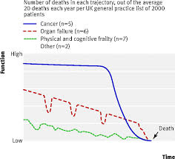
Palliative care and the disease trajectory
Source: Murray, S. A et al. BMJ 2008;336:958-959

Slide 15
Place of palliative care in the healthcare systems
POPULATION
Healthy
persons
Potentially curable
patients
Chronic/ incurable patients
PREVENTIVE
CURATIVE
PALLIATIVE
National Healthcare Systems/Programs
Source: Tamari Rukhadze, National Cancer Centre, Georgia

Slide 16
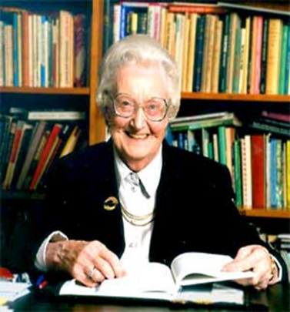
PHYSICAL
Pain
Other symptoms
Effects of medication
Fatigue
SOCIAL
About family and future
Palce of work/income
Social isolation
Loss of independence
TOTAL
PAIN
PSYCHO-EMOTIONAL
Worries about the future
Fear of pain and loss
Depression
SPIRITUAL
Why me?
Am I being punished?
What is the sense of my life?
What will be after death?
Dame Cicely Saunders (founder of modern palliative care, 1967)
defined the concept of TOTAL PAIN as
the suffering that encompasses all of a person's physical, psychological, social, spiritual, and practical struggles.

Slide 17
Estimated need for Palliative Care
WORLDWIDE
Estimated
about 40 million people need palliative care
Reality
Only about 14% currently receive it
78% of them are in low and middle-income countries
Source:WHO: https://www.who.int/news-room/fact-sheets/detail/palliative-care
ROMANIA
Estimated¹ over 172,000 persons/year
60% of all patients dying/year
all patients dying of cancer and 2/3 of those dying of other causes
Reality:
only 11.5% currently receive palliative care
17 counties (of 41) have no palliative care services
Stjernward J, in Doyle et al, Oxford Textbook of palliative care, Oxford University Press, NCHSPC, 2003

Slide 18
What patients appreciate most in palliative care
Patients and families associated good palliative care with:
  1st Emotional experience of care
  2nd Psycho-social aspects of care and support
  3rd Professional competences in physical symptoms control
Psycho-emotional support expected in palliative care:
  dignity,
  acceptance,
  empathy,
  respect for the patient’s wishes,
  flexibility
  Source: Samson C, Finlay I,The practice of palliative care from the perspective of patients and carers, MNJ Support Palliat Care doi: 10.1136/bmjspcare-2013-000551, http://spcare.bmj.com/content/early/2014/01/16/bmjspcare-2013-000551.short?rss=1

Slide 19
Impact of palliative care on patients and families
Gabe’s Story
https://www.youtube.com/watch?v=NkmzfNDhxx8
List at least three characteristics of palliative care that you noticed from the video, as compared to the biomedical model that is being practiced and that you have been familiar with

Slide 20
To conclude:
WE CANNOT ALWAYS cure,
BUT WE CAN ALWAYS care
WE CANNOT ALWAYS remove the pain of a loss, but
BUT WE CAN ALWAYS support the bereaved
WE CANNOT ALWAYS give an answer, but
BUT WE CAN ALWAYS listen to the questions

