Slide 1
Self-awareness in communication
Notes:
Communication skills are important for patient’s wellbeing, for ensuring proper care and a therapeutic patient – doctor relationship. Doctors have to aware of their strengths and shortfalls in the area of communication.

Slide 2
Learning Objectives
After completing this lesson, you should be able to:
KNOWLEDGE
Critically reflect on own (his/her) strengths and areas for improvements in applying communication skills in medical practice
SKILLS
Perform a self-assessment of own communication skill
Seek and discuss feedback received concerning own communication skills

Slide 3

Vizualizati videoclipul si notati observatiile pe care le aveti referitor la
modul de comunicare. Ce sugestii aveti?

Slide 4
Connection between self-awareness and effective communication
Self-awareness means that you know how your thoughts, emotions and behaviors affect others and you’re able to manage yourself so that the other person is an important part of the conversation.
In the case of physicians, self-awareness is their insight into how their emotional makeup influences patient care.
• Self-awareness helps you be more comfortable with yourself so you can relate to others with genuine confidence and kindness.

Slide 5
Connection between self-awareness and effective communication
• Self-awareness allows you to get out of the way and let people tell you what’s important to them without letting your stuff complicate the interaction.
• Self-awareness gives you the ability to shift from always having to talk (the result of ego) to active listening to people instead.

Slide 6
Connection between self-awareness and effective communication
• Self-awareness helps you communicate with others on a deeper level because you make them feel valued and important.
• Self-awareness helps you understand how others see you and how you can adapt to make more meaningful connections and build stronger relationships.
• Self-awareness helps you collaborate with others.

Slide 7
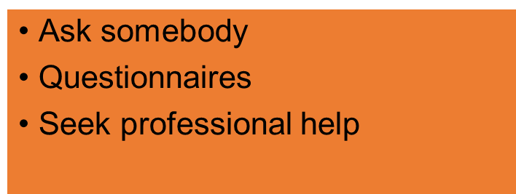
Knowing your strengths and weaknesses.
Self-awareness helps you develop your strengths and cope with your weaknesses
The ability to conduct oneself as a reflective and accountable practitioner including seeking out sources of informed criticism and valuing, reflecting and responding to them appropriately.
Enquiring into own competence and evaluating own capabilities and personal effectiveness

Slide 8
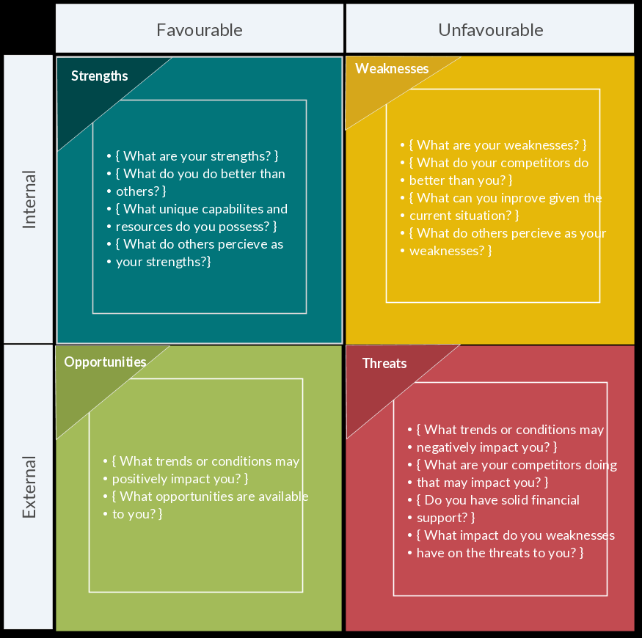
SWOT

Slide 9
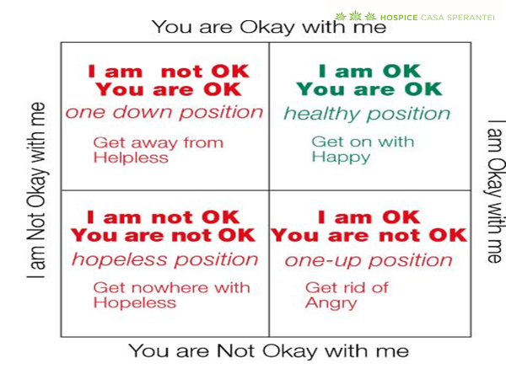
ASERTIVITATE

Slide 10
Passive behavior/ aggressive behavior/assertive behavior
PASSIVE BEHAVIOR (SUBMISSIVE)
ASSERTIVE BEHAVIOR
AGGRESSIVE BEHAVIOR
If we would arrange on a scale the two extreme behaviors, passive and aggressive, the assertive behavior is not in the middle, as we would expected
Assertive behavior is much closer to aggressive behavior, being different through:
Respects rights and freedom of persons
Analyses behaviors, not persons

Slide 11

Which are the key elements for and efficient communication?
Watch the video and analyze the key elements for an efficient communication. Reflect on your own way of communication

Slide 13
Homework
Self study:
Interpersonal communication skills inventory
https://docplayer.net/1544966-Interpersonal-communication-skills-inventory.html

Slide 14
This project has been funded with support from the European Commission.
This publication [communication] reflects the views only of the author, and the Commission cannot be held responsible for any use which may be made of the information contained therein.

